Slide 1
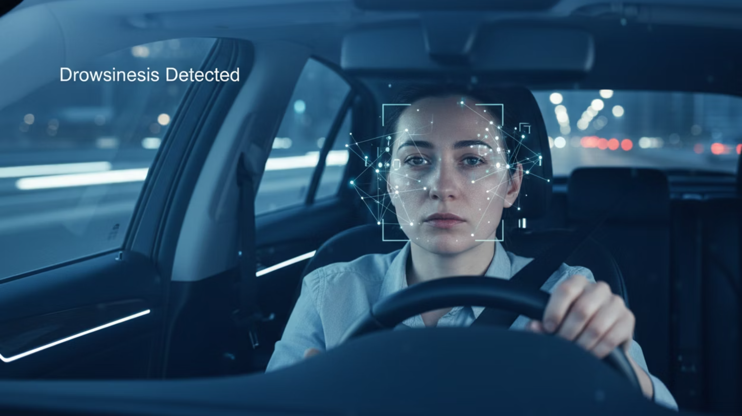
Driver Drowsiness Detection Using CNN and LSTM
Course: PG-DBDA
Technologies Used: CNN, LSTM, Python, TensorFlow/Keras

Slide 2


Introduction
What is Driver Drowsiness?
Why Detection is Important?
Reduced alertness and slower reaction time
Road accidents due to drowsy driving: ~1.35 million annually (WHO)
Caused by fatigue, long driving hours, or sleep deprivation
Fatigue-related crashes account for 20-30% of fatal accidents
Real-time detection can prevent accidents and save lives

Slide 3
Problem Statement
Challenges of Manual Monitoring
Need for Automated Real-Time System
Human observers cannot monitor 24/7
Continuous monitoring without human intervention
Subjective and prone to errors
Objective and consistent detection
High operational costs
Cost-effective and scalable solution
Immediate alert generation for driver safety

Slide 4
Dataset Description
Our model was trained and evaluated using a comprehensive dataset from Kaggle, specifically designed for drowsiness detection.
Dataset Source
Image Specifications
Kaggle (Drowsiness-cut dataset)
Resolution: 100×100×3 (RGB)
Format: PNG
Classes
Total Samples
Drowsy: Eyes closed or partially closed
7K+ images for training and validation
Non-Drowsy: Eyes open and alert
Data Split
Note
Training: 80%
Classes are balanced to ensure fair training and prevent bias.
Validation: 20%

Slide 5







Overall System Workflow
Video Input
From webcam
Frame Extraction
30 frames per second
Preprocessing
Resize to 100×100, normalize
CNN Feature Extraction
Spatial features
LSTM Sequence Processing
Temporal patterns
Classification
Drowsy/Alert
Alert Generation
If drowsy detected

Slide 6



CNN Model Architecture
Purpose of CNN
Layers Used:
Why CNN is Used?
Extract spatial features from images
Conv2D: 32, 64, 128 filters (3×3 kernels)
Excellent for image classification
Identify eye patterns and facial features
BatchNormalization: Stabilize training
Captures local spatial patterns
Efficient feature extraction
MaxPooling: Reduce dimensionality
Dense: Fully connected layers (256, 128 neurons)
Dropout: Prevent overfitting (0.5 rate)

Slide 7




LSTM Model Architecture
Purpose of LSTM
Sequence Configuration:
Layers Used:
Capture temporal dependencies in sequences
Sequence Length: 30 frames
LSTM: 128 units with return_sequences=True
Input Shape: (30, feature_size)
Learn patterns across consecutive frames
LSTM: 64 units
Dropout: 0.3 rate
Dense: 32 neurons (ReLU activation)
Output Dense: 1 neuron (Sigmoid activation)
Why Temporal Learning is Required?
Drowsiness is a temporal phenomenon
Single frame insufficient for accurate detection
LSTM captures eye closure patterns over time

Slide 8






Combined CNN + LSTM Architecture
Input
100×100×3 image
CNN Feature Extraction
Conv2D, BatchNorm, MaxPool layers
Feature Vector
Feature Buffer
30 frames
LSTM Processing
128 units, 64 units
Dense Layer
32 neurons
Output
Drowsy/Alert probability
The CNN extracts spatial features from each frame, which are then buffered and processed by LSTM to capture temporal patterns for accurate drowsiness detection.

Slide 9
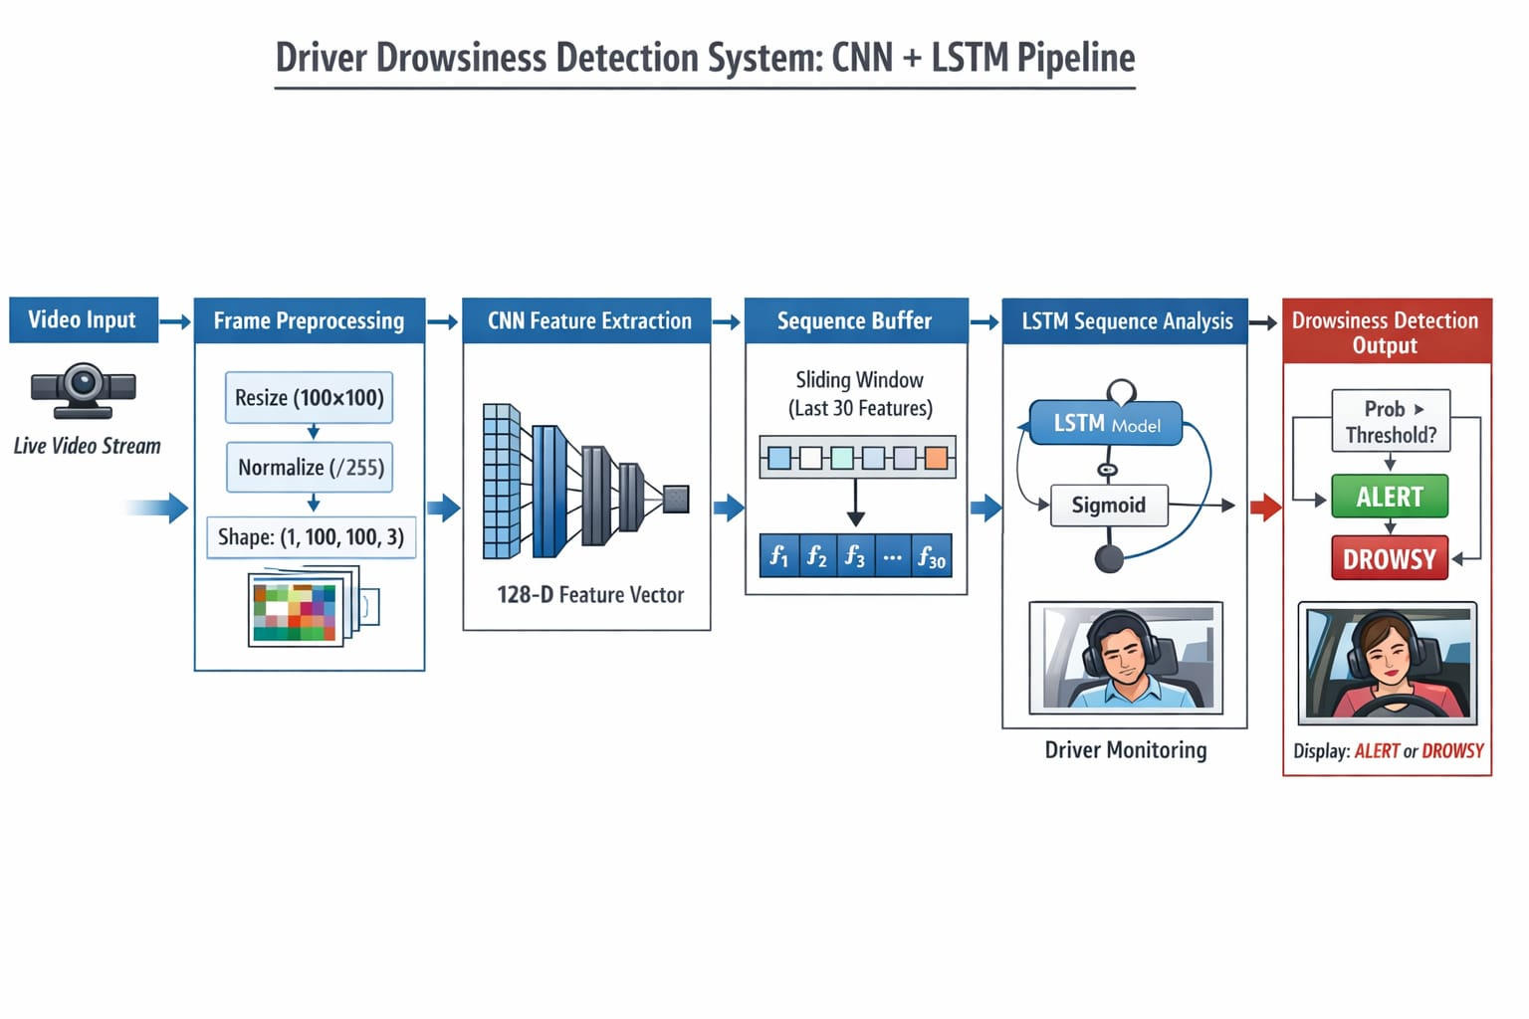

Slide 10



Training Details
Optimizer
Loss Function
Early Stopping
Adam
Binary Cross Entropy
Monitor validation loss
Learning rate: 0.001
Suitable for binary classification (Drowsy/Non-Drowsy)
Patience: 5 epochs
Adaptive learning rate optimization
Prevents overfitting
Class Imbalance Handling
Training Configuration
Class weights: {0: 1.0, 1: 1.5}
Batch Size: 30
Weighted loss function
Epochs: 30 (with early stopping)
Ensures fair training for minority class

Slide 11




Real-Time Detection
Webcam Input
Frame Processing
Continuous video stream from camera
Extract frames at 30 FPS
Real-time processing capability
Resize to 100×100 pixels
Normalize pixel values
Buffer 30 frames for LSTM input
Alert Generation
Performance Metrics
Probability threshold: 0.5
Latency: <100ms per frame
If probability > 0.5: ALERT alert
Real-time processing on CPU/GPU
If probability ≤ 0.5: DROWSY (driver is drowsy)
Audio/Visual alert triggered immediately

Slide 12



Results and Evaluation
Our model demonstrated robust performance across various metrics, confirming the effectiveness of the CNN-LSTM hybrid approach.
94.5%
93.2%
Accuracy
Precision
Overall correct predictions
Correct positive predictions
95.8%
94.5%
Recall
F1-Score
Actual positives identified
Balance of precision & recall
The confusion matrix further illustrates the model's ability to distinguish between drowsy and alert states with high reliability.
1,245
1,189
85
51
True Positives
True Negatives
False Positives
False Negatives
Drowsy detected
Alert detected
Alert incorrectly identified as drowsy
Drowsy incorrectly identified as alert
95.2%
96.1%
Drowsy Class Precision
Drowsy Class Recall
93.5%
95.8%
Non-Drowsy Class Precision
Non-Drowsy Class Recall
Key Findings:
Hybrid Approach Superior
Temporal Features Crucial
Minimal False Positives
CNN-LSTM hybrid approach outperforms single models in drowsiness detection.
The integration of temporal features is crucial for accurate and reliable detection.
Low false positives ensure driver confidence and prevent unnecessary alerts.

Slide 13




Advantages
Real-Time Performance
Reduced False Predictions
Scalability
Processes video at 30 FPS
High precision (93.2%) and recall (95.8%)
Works on CPU and GPU
Latency < 100ms per frame
Can be deployed on edge devices
Suitable for live deployment
Minimal false positives and false negatives
Lightweight model suitable for embedded systems
Reliable for critical safety applications
Robustness
Cost-Effective
Handles varying lighting conditions
No specialized hardware required
Works with different face orientations
Uses standard webcam input
Effective across diverse user demographics
Reduces operational costs

Slide 14





Applications
Driver Safety Systems
Smart Vehicles
Accident Prevention
Integrated into vehicle dashboards
Autonomous vehicle safety enhancement
Early warning system for drowsy drivers
Real-time alerts to prevent accidents
Reduces fatigue-related crashes
Backup system for self-driving cars
Reduces road fatalities and injuries
Ensures driver attention in semi-autonomous modes
Improves overall traffic safety
Transportation Industry
Healthcare and Monitoring
Commercial vehicle monitoring
Patient monitoring in hospitals
Fleet management systems
Fatigue detection in critical operations
Compliance with safety regulations
Workplace safety applications

Slide 15
Conclusion
Our journey through the Drowsiness Detection System has highlighted a robust and efficient solution for a critical real-world problem. Here's a summary of its performance, key achievements, and profound impact:
Summary of System Performance
Key Achievements
Impact
Effective spatial-temporal feature extraction
Potential to save thousands of lives annually
Successfully developed CNN-LSTM hybrid model
Robust drowsiness detection across diverse conditions
Reduces road accidents and injuries
Achieved 94.5% accuracy on test dataset
Improves driver and passenger safety
Scalable and cost-effective solution
Contributes to smart vehicle technology
Real-time detection with <100ms latency
Ready for real-world deployment
Minimal false positives (85 out of 1,570 predictions)
Ultimately, the goal of this project extends beyond technological innovation to direct, life-saving applications.
"The CNN-LSTM hybrid approach demonstrates the power of combining deep learning architectures to solve critical real-world problems. This system is a significant step toward safer roads and smarter vehicles."

Slide 16




Future Enhancements
Yawn Detection
Attention Scoring
Extend model to detect yawning as additional drowsiness indicator
Develop attention level scoring system (0-100%)
Provide continuous driver alertness metrics
Combine eye closure and yawn detection for improved accuracy
Enable gradual alerts before critical drowsiness
Better driver feedback and awareness
Multi-modal approach for comprehensive fatigue assessment
Mobile Deployment
Advanced Features
Optimize model for mobile devices (Android/iOS)
Integration with vehicle control systems
Reduce model size for edge computing
Machine learning model updates with new data
Enable smartphone-based drowsiness detection
Multi-person detection for shared vehicles
Wider accessibility and adoption
Integration with IoT and smart home systems

